Slide 1
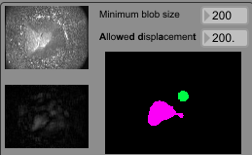
Deformated area
a)
c)
b)
Deformation after baseline removal
Detected blobs

Slide 2
Negative
Zero
Positive
Curve
output
output
output
input
input
input
Compressor
output
output
output
input
input
input

